Slide 1
Overview of FEA
Erik Knudsen

Slide 2

Health warning!
We will be using the finite element method (FEM) extensively in this laboratory session.
For you, the student, the software is a “means to an end.”
This session is serves as a ‘soft’ introduction to using the FEM to solve a relatively straightforward analysis.

Slide 3
Why use FEM? If you ask an expert, you will hear…
“Time consuming”
“Hard and not
user friendly”
“Frustrating!”
“Powerful!”
“Very popular”
“Necessary”

Slide 4
Words of Wisdom
FEM is a powerful modeling tool… but use it with care.
Note that FEM is an approximation → ALL models are wrong, but some are useful.
“An FEM program allows an engineer to make mistakes at a rapid rate of speed.” – R. Miller
“An error caused by misunderstanding or oversight is not correctable my mesh refinement [making elements smaller] or by use of a more powerful computer.” – R. Cook

Slide 5
When to call on FEM?
Question: How does one know it is time to use FEA software?
Answer: When the complexity of the problem warrants the complexity of the analysis technique!
In other words, it is very important to conduct a lot of pre-planning and ask yourself if FEA is really needed!
FEA has a steep learning curve
Important to know the desired level of accuracy

Slide 6
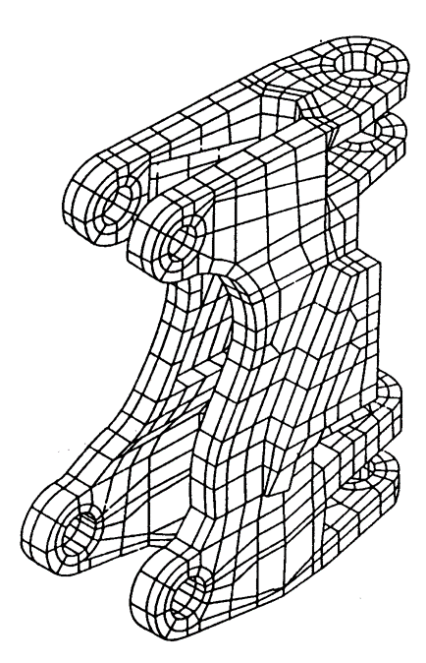
What are the advantages?
Model irregularly shaped parts quite easily
Handle general load conditions without much difficultly
It is possible to model bodies made from many materials
Possible to model the effects of many different types of boundary conditions
3D model of a casting used in a backhoe frame

Slide 7
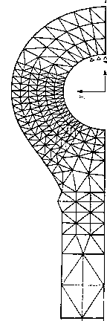
What are the advantages?
Vary the size of elements to make it possible to use small elements where necessary
Alter the FE model quite rapidly and cheaply
Include dynamic effects
Handle nonlinear material behavior (plasticity, large deformations, contact)
2D hydraulic cylinder rod end – a symmetric model was built and note regions with a refined mesh

Slide 8
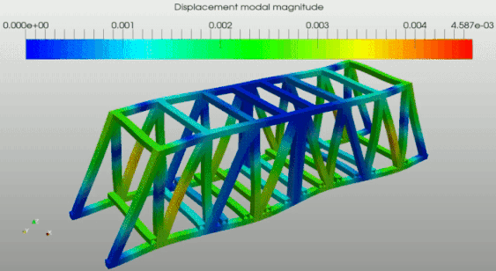
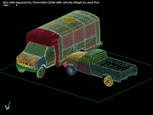
FEM Applications
FEM can analyze structural and non-structural problems.
Common structural applications include:
Stress analysis (trusses, towers, bridges, building frames), stress concentration effects (changes in geometry such as holes and fillets)
Buckling of columns and frames
Vibration analysis
Impact and shock analysis

Slide 9
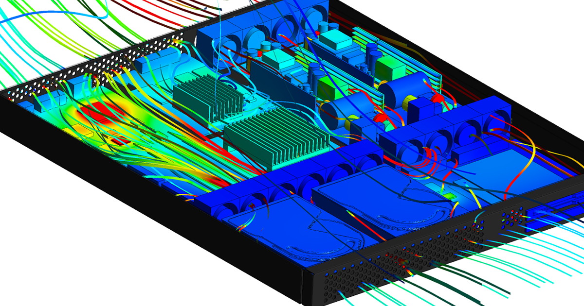
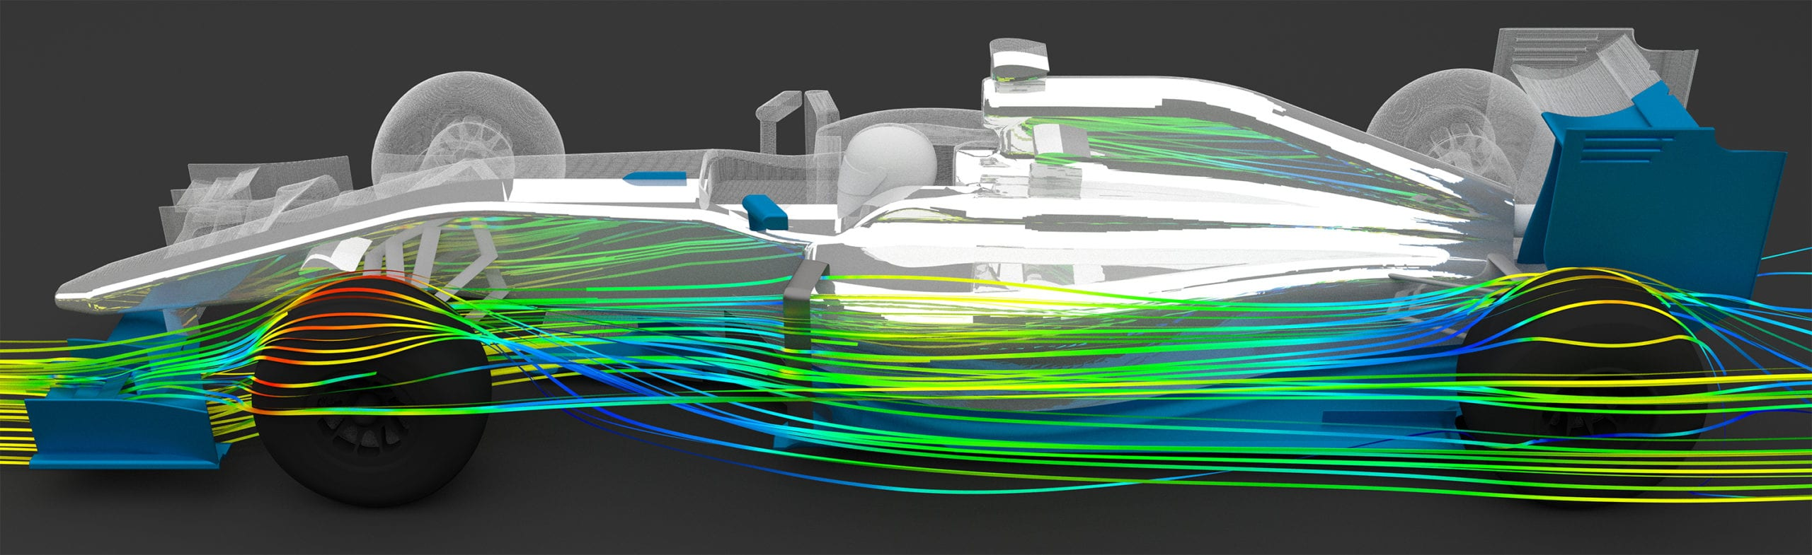
FEM Applications
Common non-structural applications include:
Heat transfer (cooling systems in laptops or your cell phone)
Fluid flow (air flow around a race car)

Slide 10
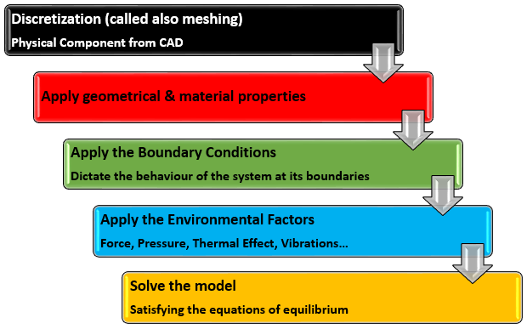
General steps in an analysis

